Slide 1
Car2know
“ No more or know more, that is the question ”
Xiasen Wang
Yuxuan Cheng
Geng Zeng
Zhe He

Slide 2
Contents
Introduction & Motivation
Data Sets
Use Cases
Design
Demonstration

Slide 3
MOTIVATION
Emerging Uber, Lyft and Car2Go have become important means of transportation in our daily life. Our group wants to analyze the Car2Go flux information based on the census blocks in Seattle as well as visualize it in Python. It will provide insight into the supply and demand for customers, car rental companies, as well as city planners and business analysts.

Slide 4
DATA SETS
Car2Go API Query
(txt file)
Hle Census Block Group
(ArcGIS format)
Time
Location
Car ID
Fuel level
shp
dbf
sbn
shx

Slide 5
USE CASES
User: Select time and location
System: Provide influx and outflux information
User: order a car
System: change the influx and outflux information

Slide 6
DESIGN
Choose the block
Get the flux info
Enjoy the service
The users click the block where they would like to pick up a car
See the flux graph, have the idea about Car2Go flux
Leave some feedbacks.
Select a time
Order a car
Select an approximate time when they will take the car
Choose a convenient location and make an order

Slide 7
DEMONSTRATION
Know More >

Slide 8
Pick Data
Using car2go API to request data in Seattle every 30 seconds
Return information of all available cars’ information
Compare two adjacent data:
If a car appears: a trip ends
If a car disappears: a trip starts
Data are from January to May in Seattle, and there are about 330,000 trips in total

Slide 9
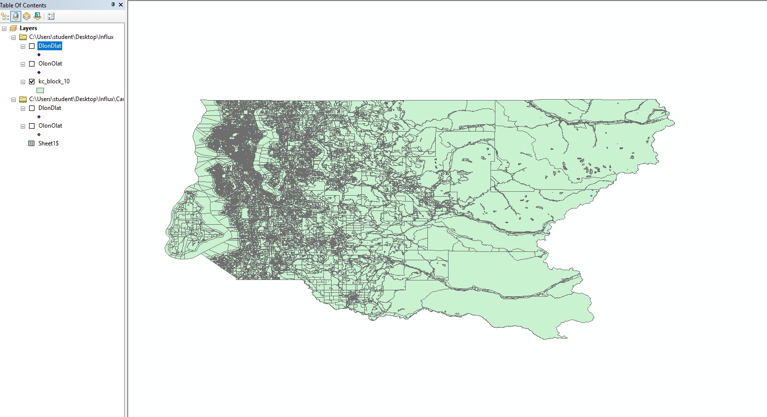
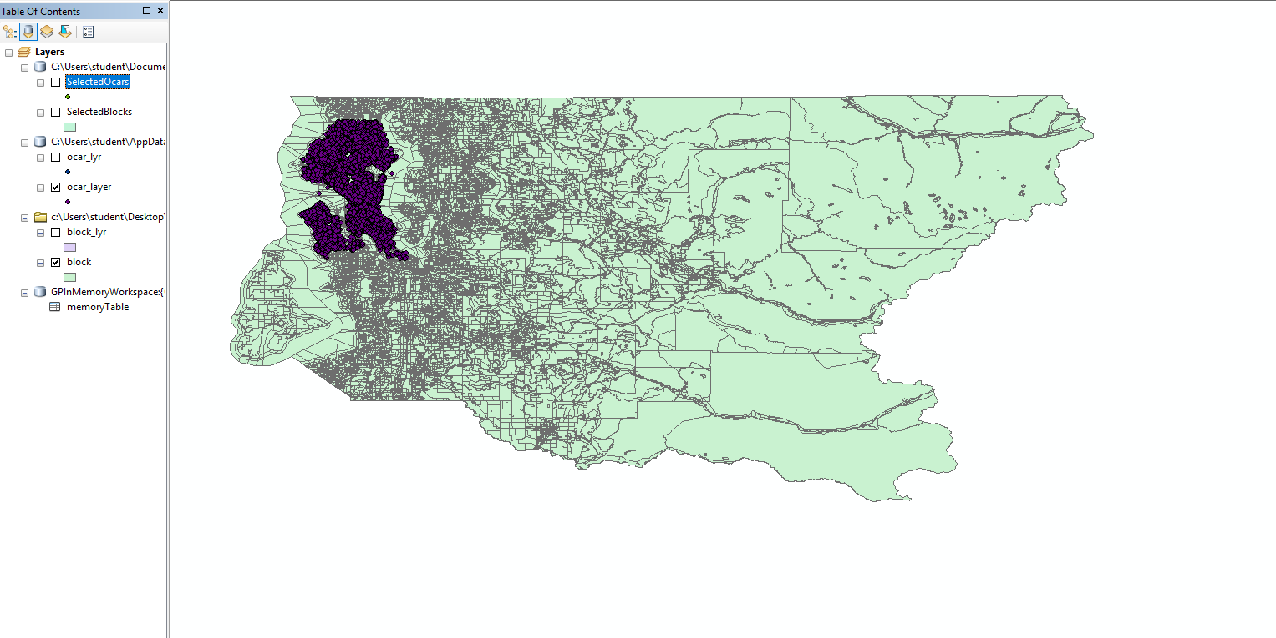
Data in ArcGIS
import arcpy
import arcpy.mapping
path = "c:/Users/student/Destop/O"
arcpy.env.workspace = path
mxd = arcpy.mapping.MapDocument("CURRENT")
df = arcpy.mapping.ListDataFrames(mxd,"*")[0]
arcpy.MakeFeatureLayer_management('c:\Users\student\Desktop\O\kc_block_10.shp','block')

Slide 10
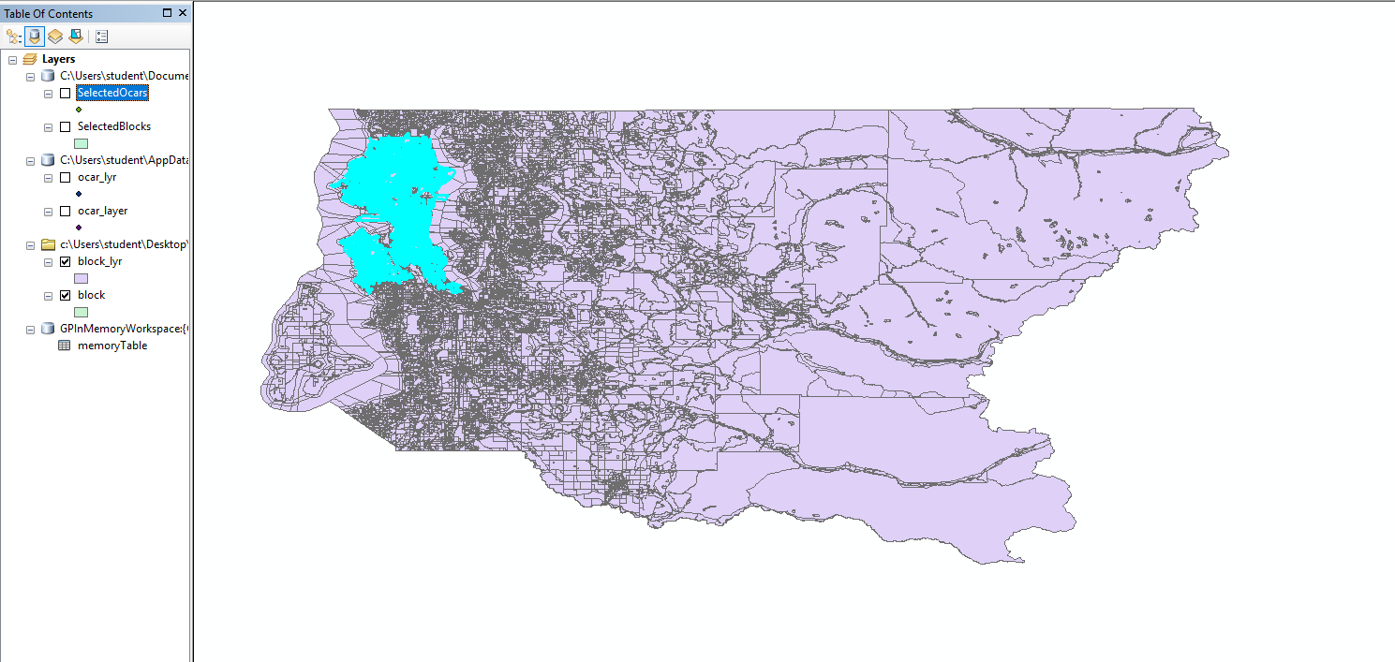
Data in ArcGIS
arcpy.MakeXYEventLayer_management("memoryTable", "olon", "olat", "ocar_layer",r"Coordinate Systems\Geographic Coordinate System\North America\Nad 1983","")
arcpy.MakeFeatureLayer_management('block', 'block_lyr')
arcpy.SelectLayerByLocation_management('block_lyr', 'intersect', 'ocar_layer')

Slide 11
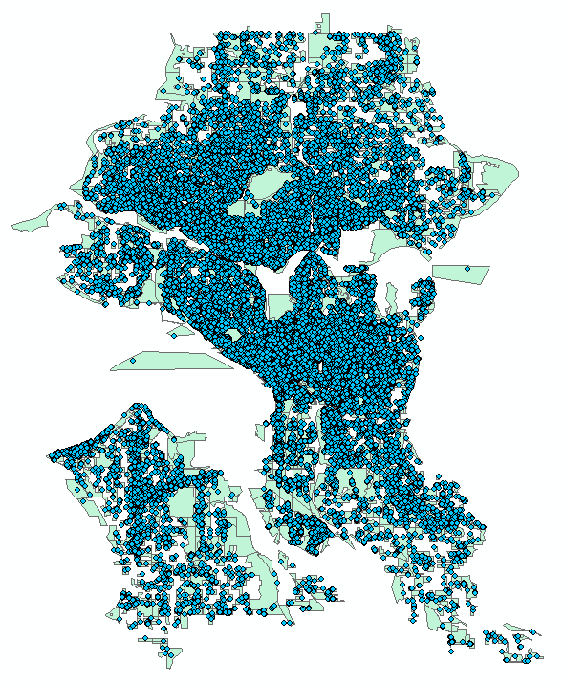
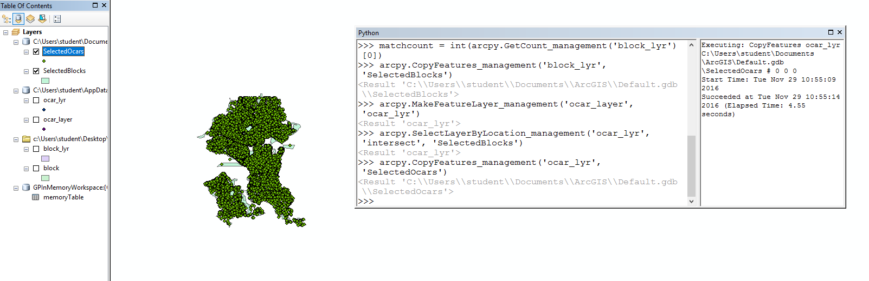
Data in ArcGIS

Slide 12
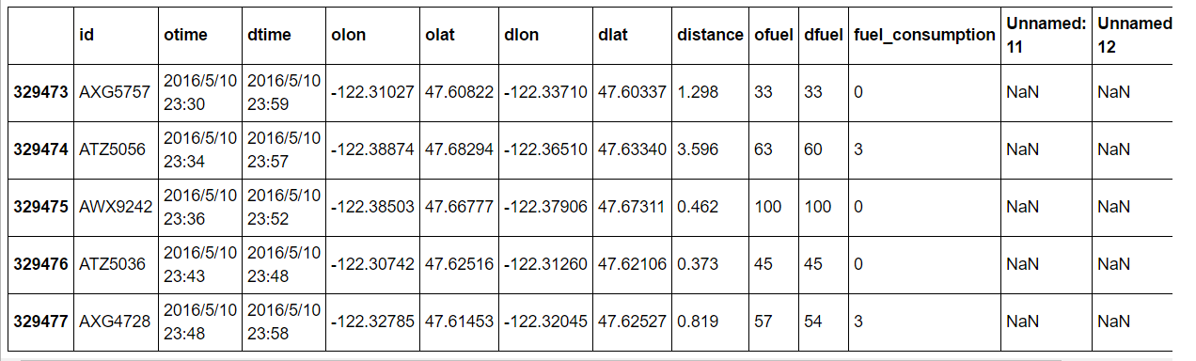
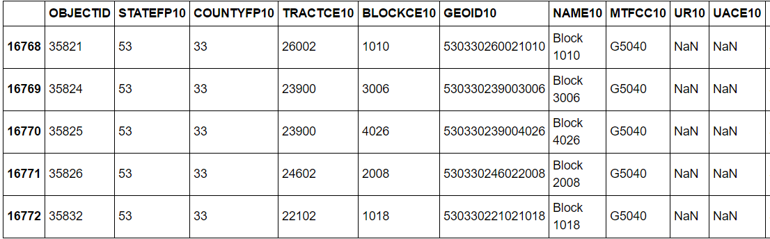
Data Calculation
Car2go data
~330k trips
unique identifiers
Blocks data
~17k blocks

Slide 13
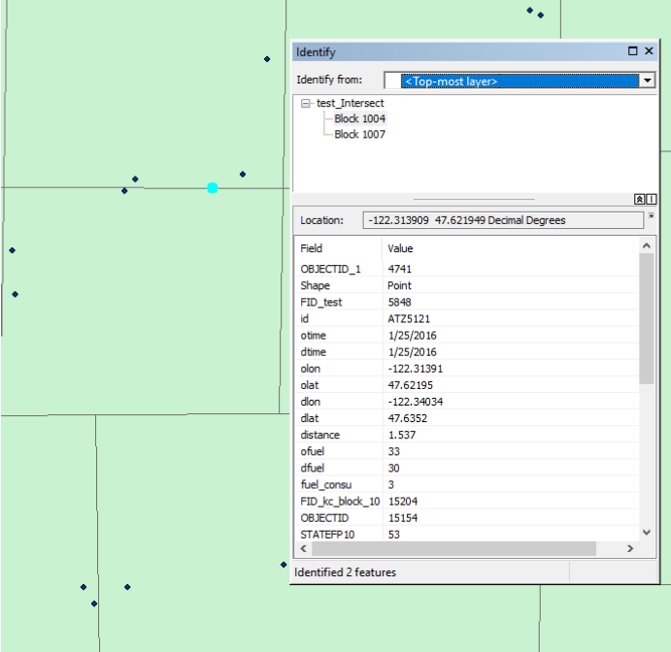
Data Calculation
Option 1: ArcGIS UI operation
Option 2: ArcPy scripting
Watching out for out-of-bound trips and trips that fall exactly on the boundary of blocks/tracts

Slide 14
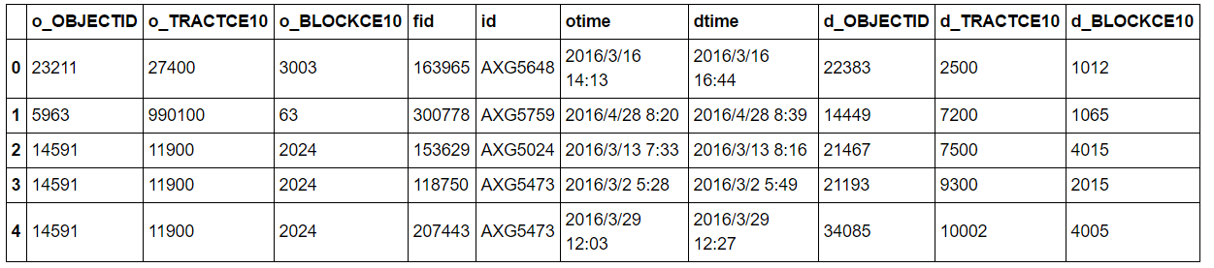
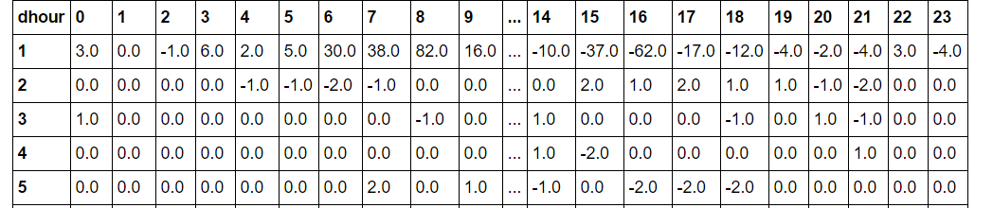
Data Calculation
Combined data
by destination or origin
Output: Flux data
9020 x 24 (blocks)
495 x 24 (tracts)

Slide 15
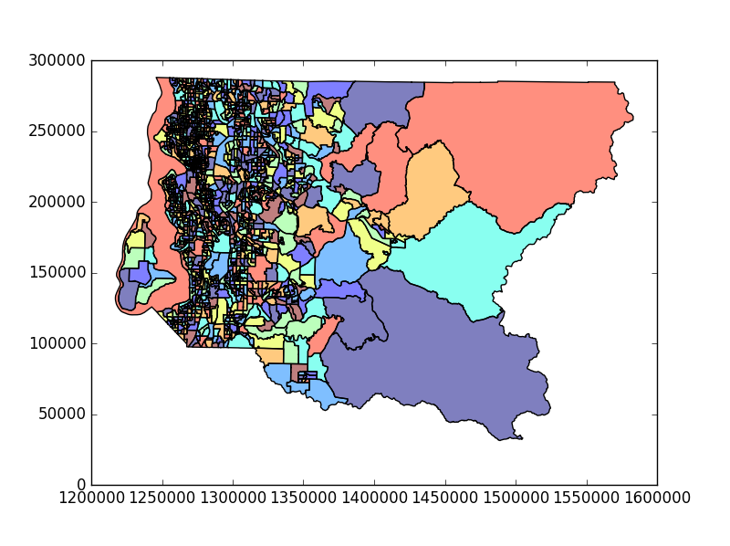
Visualization
pip install fiona
git clone https://github.com/geopandas/geopandas.git
cd geopandas
pip install
import shapely
import geopandas as gpd
import pysal
from scipy import ndimage
GeoPandas
An open source project to make working with geospatial data in python easier
GeoPandas extends the datatypes used by pandas
A GeoDataFrame is a tabular data structure that contains a GeoSeries
Always has one GeoSeries column that holds a special status. This GeoSeries is referred to as the Geo DataFrame‘s “geometry”
Geometric Objects (actually shapely objects):
Points / Multi-Points
Lines / Multi-Lines
Polygons / Multi-Polygons

Slide 16
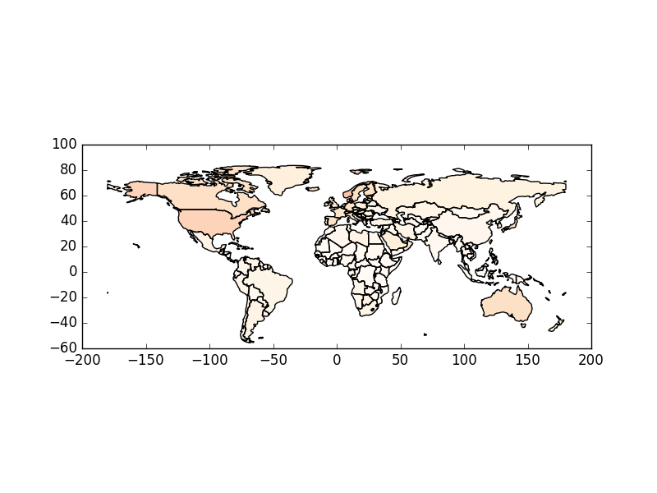
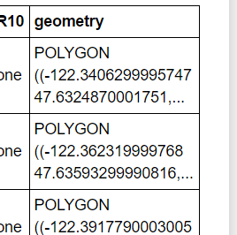
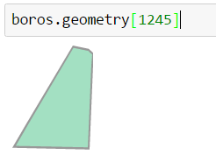
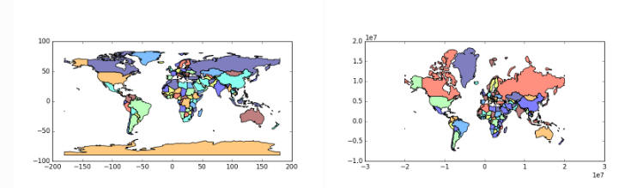
Visualization
Mapping shapes
flux_map.plot(column = str(hour), cmap = cmapstr,figsize = (size))
Reading Spatial Data
gpd.GeoDataFrame.from_file(‘*.shp')
“geometry”
Projections

Slide 17
Point map
Heat map

Slide 18
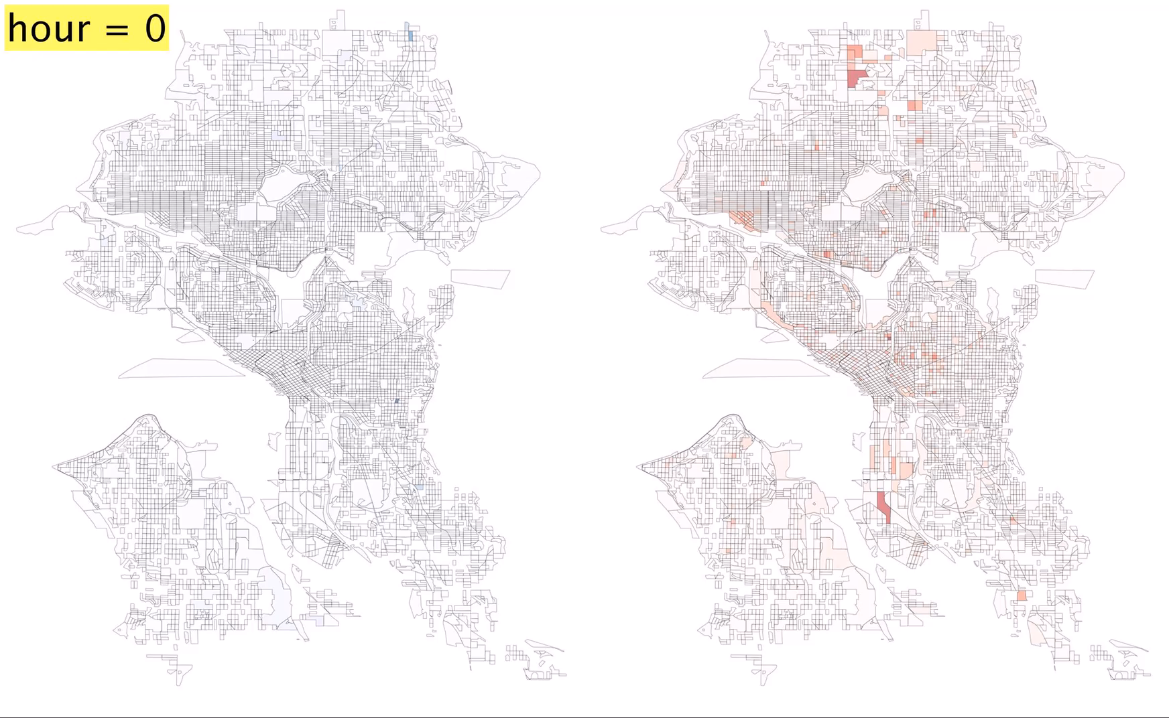
Flux in
Flux out

Slide 19
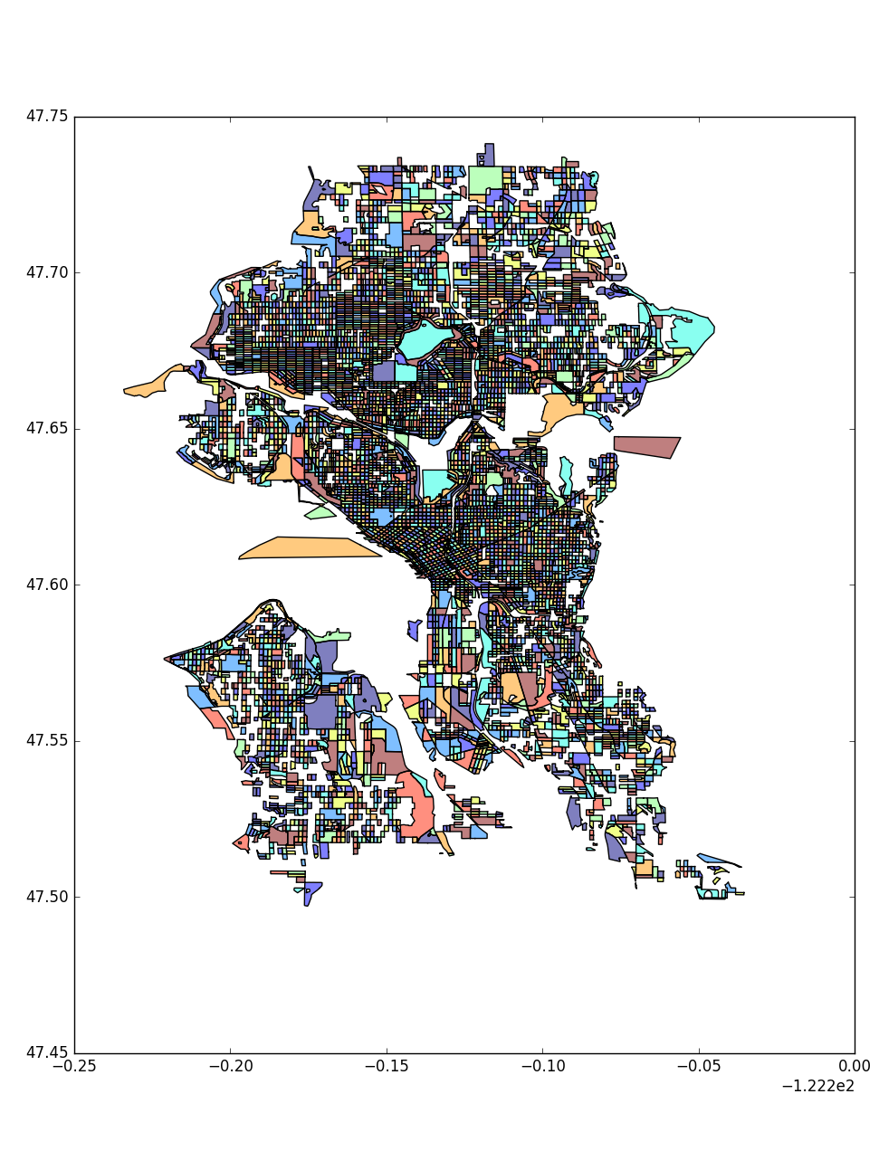
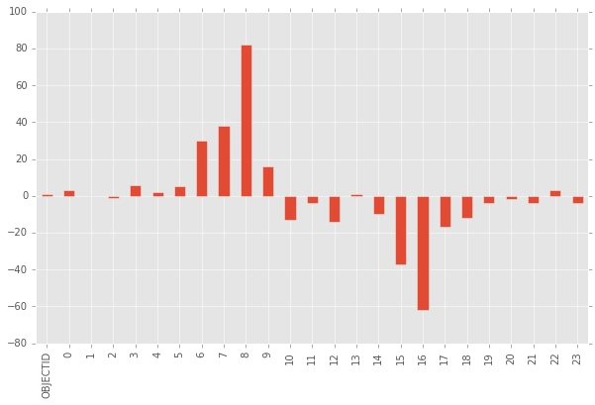
Statistical analysis
In
Out
Hour

Slide 20
Find the redistribution area

Slide 21
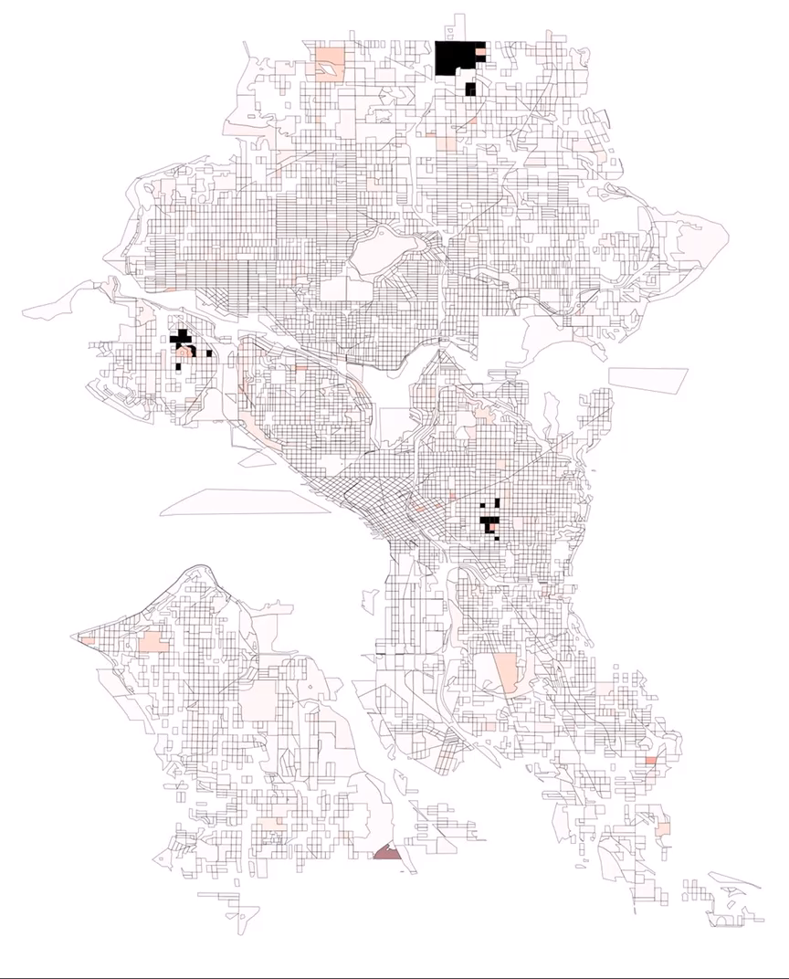
Redistribution map

Slide 22
THANK YOU

